Slide 1



Data Science and Food Waste
Reducing Food Waste through Data-Driven Solutions
Elena Zanda - December 2022

Slide 2

FOOD WASTE
Food waste is a significant issue in our society,
with an estimated one third of all food produced in the world being lost or wasted.
1.3 BILLION TONS A YEAR

Slide 3
The aim of this project
This project was designed and developed with the aim to use data science to make a small contribution to reducing food waste.
Through this project I have been able to create an ingredient filter to help me find recipes with the ingredients I have on hand, and also develop a recipe recommender system.
Notes:
Every week I get my box of “ugly” fruit and vegetables, and I have to work out what I can make with the ingredients I have.
Simply type in the ingredients you have available, and our database will search for recipes that include those ingredients. You can also filter your search by cuisine, course, and dietary restrictions to find the perfect recipe for your needs.
So why wait? Start searching for recipes now and get cooking!

Slide 4
The approach
Identifying the dataset
Cleaning and visualising the data
developing the algorithm
Validating the results

Slide 5
The data

Slide 6
introducing
The data
The data used comes from Allrecipes.com
Founded in 1997, Allrecipes is currently the world's largest community-driven food website
Allrecipes provides trusted resources to more than 60 million home cooks each month
Notes:
How do you know if you're eating too much? When you're wasting food, that's how!

Slide 7

35515
1887
25%
Recipes
contain salt & Pepper
98%
4* rating
Ingredients

Slide 8


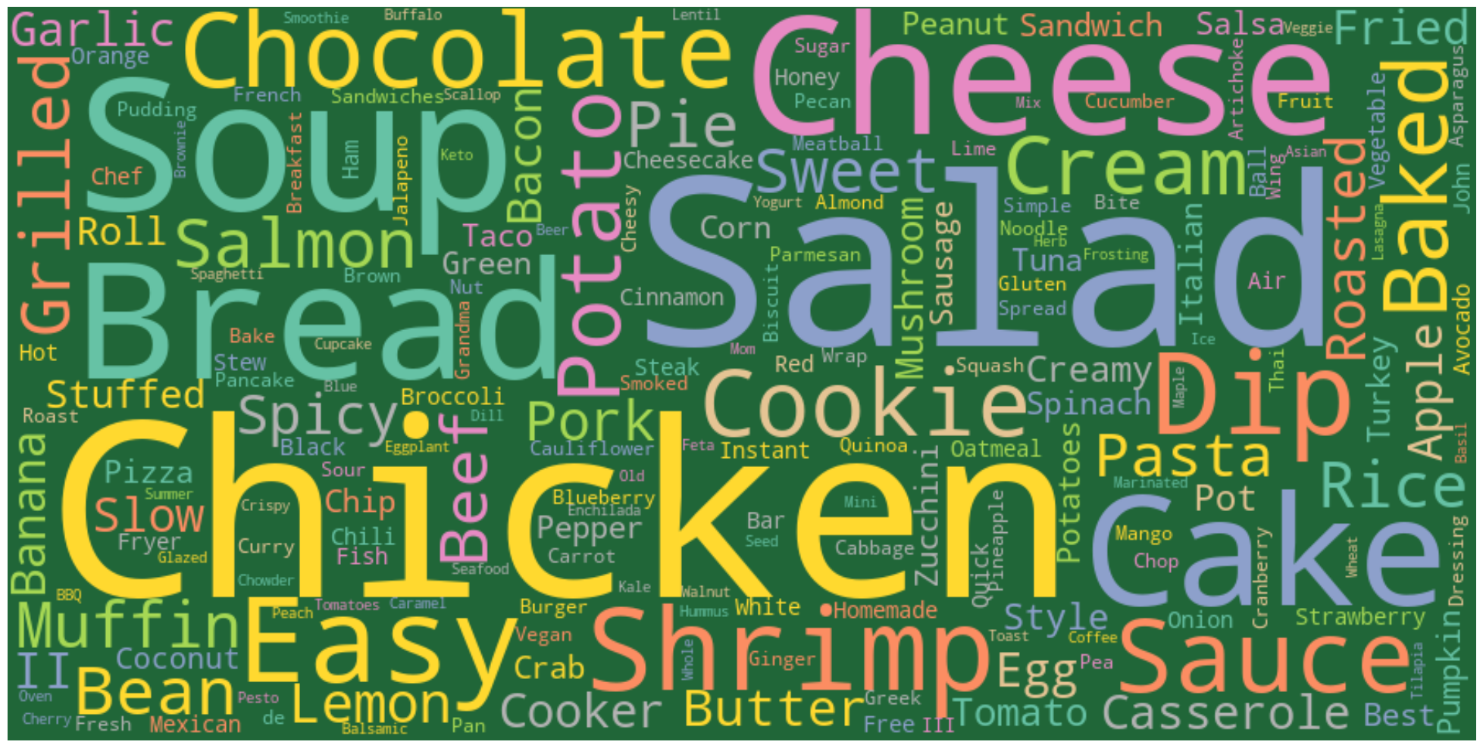


Words used in the recipe names

Slide 9
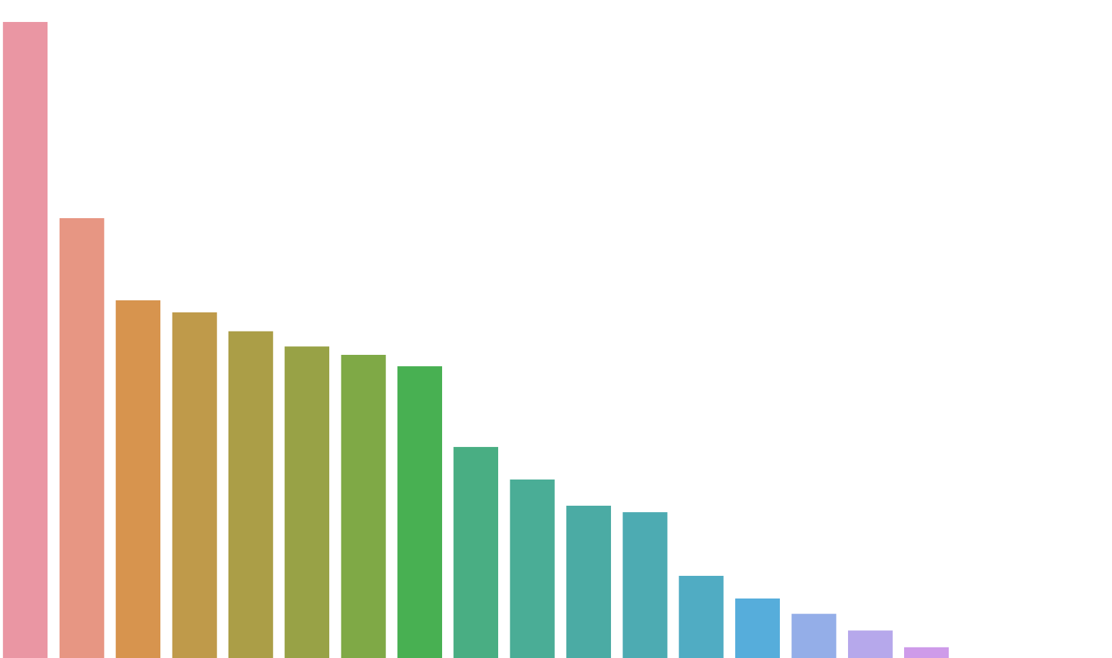
Recipe categories by popularity
breakfast
Appetizers and snacks
seafood
desserts
Side dishes
World cuisine
Main dishes
salads
breads
Soups, stews and chili
Meat and poultry
Brand tips

Slide 10
The results

Slide 11
Recipe & ingredient
system
Ingredient filter
Recipe and ingredient recommender

Slide 12
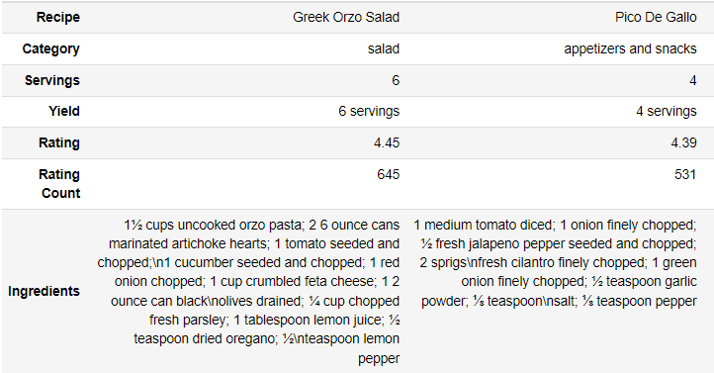
Recipe suggestion
Ingredient filter

Slide 13
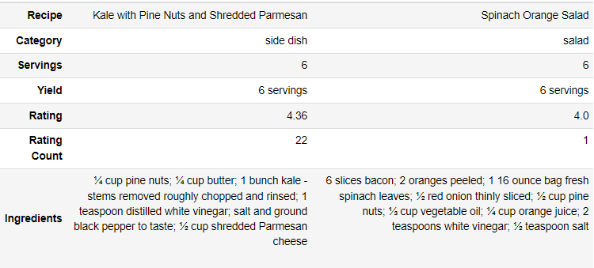
Recipe recommendation
based on another recipe

Slide 14

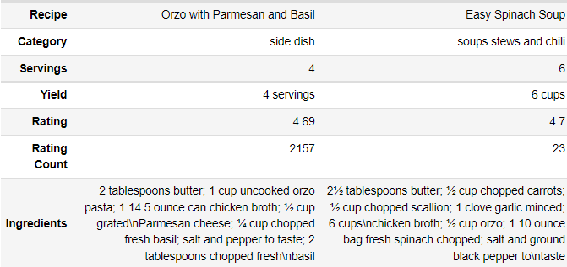
Recipe suggestion
based on one ingredient

Slide 15
thanks!
Elena Zanda

